Slide 1
Microprocessors(Lab)
Basic I/O, Advanced arithmetic operations and Flags
Tauhid Tanjim

Slide 2
Basic I/O
AH=1; single character input
AH=2;single character output
AH=9; string output
INT 21H ; call the interrupt handler 0x21 which is the DOS(Disk operating System) Function Dispatcher.

Slide 3
Basic I/O
Single Key Input:
mov ah,1
int 21h
The program will wait for the user to give an input. It will be saved in AL.

Slide 4
Basic I/O
Single Character Output:
The item to be printed must be in DL
mov dl,5
mov ah,2
int 21h
The hexadecimal values of new line is 0Ah and line feed is 0Dh

Slide 5
Displaying a String:
m1 db "hello$"
LEA DX,m1
mov AH,9
int 21h
The values of variables and arrays are stored in the data segment of the
memory. In order to fetch them we need the offset address (offset +
segment).

Slide 6
To print a string we need to store 9 in AH. While 9 is in AH, int
21h expects DX to hold the offset address of the array/variable.
LEA is the name of the instruction that provides the offset address. LEA
stands for Load Effective Address. The syntax for using LEA is: LEA
destination, source. Source is the memory address (the array or the
variable) whose offset address will be saved in the destination. The
destination is a general register. e.g. for printing the string "hello":

Slide 7
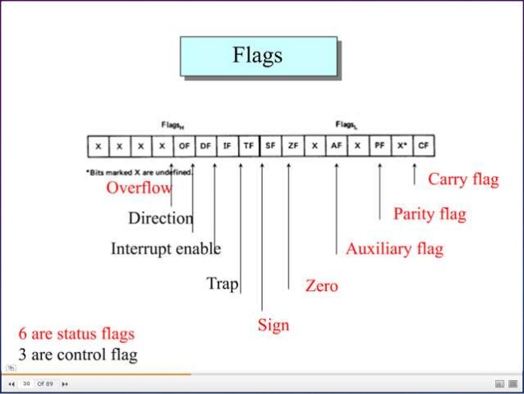
Flag register
8086 Flag Registers
(16 bits):
9 flags,
6 status flags
(conditional),
3 control flags

Slide 8
Flag Register
Carry Flag:
CF=1 (Carry occurs in MSB)
CF=0 (No such carry)
For both addition or subtraction.
1111 1111
+0000 0001
10000 0000 (CF=1)

Slide 9
Flag register
Parity Flag:
When there are even numbers of 1’s in the lower byte
PF = 1 (even parity) …. 00000000→PF status on
When there are odd numbers of 1’s in the lower byte
PF = 0 (odd parity)....... 10000000→PF status off
1111 1110
+1001 0111
11001 0101 (CF=1)
4 1’s→ so PF=1

Slide 10
Flag register
Auxiliary Flag:
when there is a carry out from bit number 3 to bit number 4 on addition or borrow into bit number 3 during subtraction. (Note that the bit number starts from 0)
1111 1110
+1001 0111
11001 0101 (CF=1,PF=1)
As carry occurs in 3rd bit so, AF=1

Slide 11
Flag register
Zero Flag (ZF):
ZF = 1, if the result of an operation in 0.
1111 1110
1111 1110
0000 0000
CF=0, PF=1, AF=0, ZF=1

Slide 12
Flag register
Sign Flag (SF):
SF = 1 when the MSB of a signed number is 1.
1011 1001
1110 0010
11001 1011
CF=1,PF=0, AF=0, ZF=0, SF=1

Slide 13
Flag register
Overflow Flag (OF): OF = 1 when there is an overflow.
Signed overflow:
Signed overflow occurs when Carry_{in}≠ Carry_{out}
1011 1001
1110 0010
1001 1011
Since Carry_{in} = Carry_{out}
OF=0

Slide 14
ANY QUESTION???

